Slide 1
Data
Modeling
Shahriar’s Analytical Academy

Slide 2
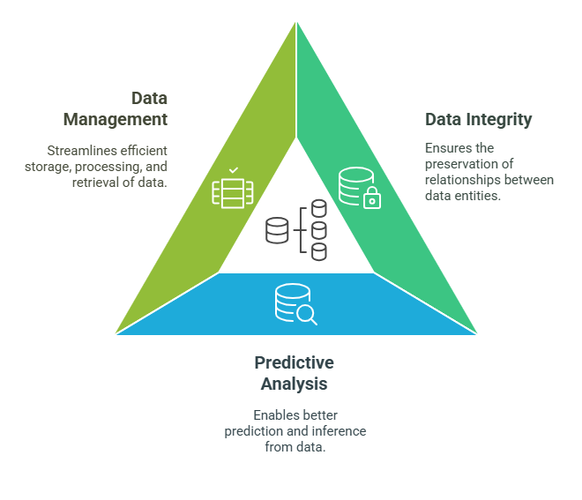
Data Modeling
Data modeling is the process of designing a conceptual framework that organizes and structures data.
This step involves creating a model or blueprint that represents the relationships and attributes of the data for efficient storage, access, and analysis.
Notes:
Data Modeling Definition: Data modeling is the process of creating a structured framework that organizes and defines the data within a system. It represents the data's relationships, properties, and constraints. Essentially, data modeling is about creating a visual or conceptual representation of how data elements interact within a database or system. The goal is to make data accessible, understandable, and usable for analysis or operational purposes.
Data models can be thought of as blueprints for databases. Just as an architect draws plans for a building, data modeling helps design how information should be structured and how different pieces of information connect with one another.
Key Importance:
Ensures Data Integrity: A key aspect of data modeling is ensuring that the data is consistent and accurate. By defining clear relationships between data entities, it helps maintain the integrity of the data. For instance, if you are building a customer database, it’s important to ensure that customer information is linked to their purchase history correctly, preserving data accuracy and avoiding data duplication.
Facilitates Predictive Analysis: A well-designed model makes it easier to use historical data to make predictions. Structured data allows analysts to apply machine learning or statistical techniques effectively, enabling organizations to forecast future trends, customer behavior, or potential risks.
Streamlines Data Management: By organizing the data in a meaningful way, it becomes much easier to store, retrieve, and process. For instance, data modeling allows systems to efficiently query information, perform transactions, or manage data in large systems, which improves the overall performance of data-driven applications.

Slide 3
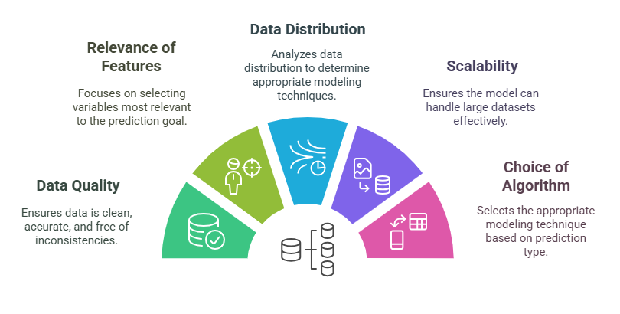
Key Factors to Consider
Notes:
Data Quality: Data quality is a crucial factor in predictive modeling. If the data is inaccurate or inconsistent, predictions will be unreliable. Ensuring that the data is clean, free of errors, and properly formatted is the first step. Missing data should be handled carefully, either by imputation (filling in missing values) or removing the affected records to avoid distorting the results.
Relevance of Features: Feature selection and engineering are key in improving the model’s performance. The features or variables used in a model should directly contribute to predicting the outcome. Irrelevant features can introduce noise, reducing the model's accuracy. Feature engineering involves transforming raw data into a format that makes it more suitable for analysis, such as scaling variables or creating interaction terms between features.
Data Distribution: Understanding the distribution of data is essential because different types of models require specific assumptions about the data’s distribution. For instance, linear regression assumes that data follows a normal distribution. If the data is skewed, transformations might be necessary. Outliers can distort predictions and should be identified and treated appropriately.
Scalability: Scalability refers to the ability of the model to handle large datasets. As data volumes grow, the model should still be able to process and make predictions in a reasonable time frame. Computational efficiency is key, and some algorithms are more efficient than others in terms of memory and processing time. When working with big data, machine learning models like decision trees or neural networks might be more scalable than traditional statistical models.
Choice of Algorithm: Selecting the right algorithm depends on the problem you are trying to solve. For classification tasks, you might use logistic regression, decision trees, or support vector machines. For regression tasks, linear regression might be suitable. Machine learning models are more flexible and can handle non-linear relationships better than statistical models, which are often limited to specific distributions or patterns.

Slide 4
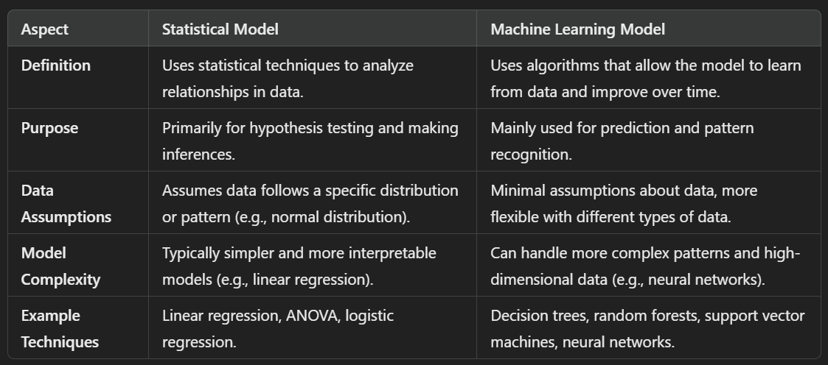
Two types of Data modeling
Notes:
Definition:
Statistical models are rooted in classical statistics and are typically focused on understanding the relationships between variables. They rely on statistical techniques like hypothesis testing, regression analysis, or ANOVA to make inferences about the data.
Machine learning models, on the other hand, involve algorithms that allow the system to "learn" from the data. These models improve over time by refining their predictions based on the input data they receive, often without requiring explicit programming for every situation.
Purpose:
Statistical models are often used when the goal is to understand the underlying relationships within data and make inferences about those relationships, such as in hypothesis testing or determining correlation.
Machine learning models are used for more complex tasks like predicting outcomes or classifying data. They are ideal for tasks where the goal is to identify patterns or make predictions from large and diverse datasets.
Data Assumptions:
Statistical models often assume that the data follows a specific distribution (such as a normal distribution), and the model’s effectiveness is dependent on these assumptions. For example, linear regression assumes linearity and normality of errors.
Machine learning models, particularly non-parametric ones, make minimal assumptions about the data, allowing them to work with various types of data without the need for strict assumptions.
Model Complexity:
Statistical models tend to be simpler and easier to interpret. For instance, a linear regression model shows clear coefficients, which makes it easy to understand the relationship between the dependent and independent variables.
Machine learning models can handle more complex data patterns and high-dimensional datasets. While they can be more accurate, they also tend to be less interpretable, especially in cases like neural networks, where the model’s internal workings are harder to understand.
Example Techniques:
Statistical techniques like linear regression, ANOVA, and logistic regression are common in statistical modeling. These techniques are relatively simple and used for inferential purposes.
Machine learning techniques such as decision trees, random forests, support vector machines, and neural networks are more complex and are commonly used for tasks like classification, regression, and anomaly detection.

Slide 5
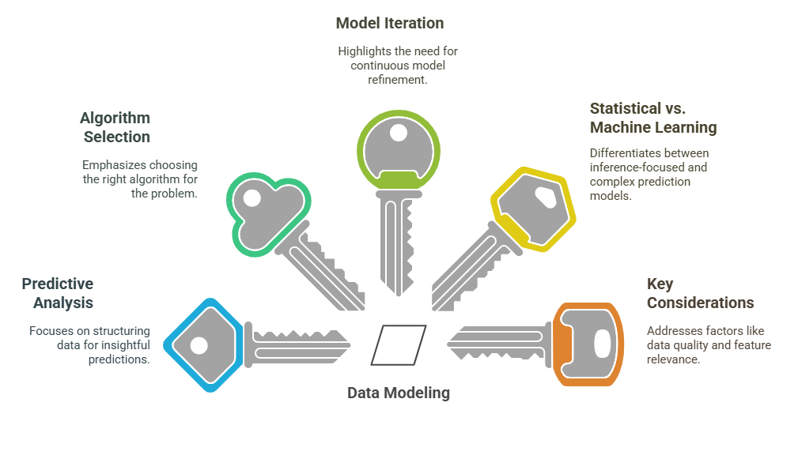
5 Key Learning Points of this Lesson
Notes:
Importance of Data Modeling: Data modeling is vital for organizing and structuring data in a way that makes it usable and valuable for analysis. By establishing a solid data model, organizations can ensure that their data is organized correctly, which helps in efficient querying, analysis, and decision-making processes.
Considerations for Predictive Analysis: For predictive analysis to be effective, several factors need to be considered, including data quality, relevance of features, and the choice of algorithms. The right combination of these elements ensures that models can make reliable and accurate predictions.
Differences Between Statistical and Machine Learning Models: While statistical models focus on hypothesis testing and interpreting data based on established distributions, machine learning models are focused on making predictions and recognizing patterns, often with fewer assumptions about the data.
The Role of Algorithms in Data Modeling: Choosing the correct algorithm is crucial. Statistical models use simpler techniques like regression, while machine learning models use more advanced techniques like neural networks. The choice of algorithm directly influences the model’s ability to predict and interpret data accurately.
Iterative Process of Model Building: Data modeling is not a one-time activity. It’s an iterative process where models are continually tested, evaluated, and refined to improve their accuracy and performance. This refinement can involve adjusting features, trying different algorithms, or revisiting data quality.

Slide 6
Thank You!
Shahriar’s Analytical Academy

